Slide 1
IOT CONTROLLING MOTOR
-Mallika Subramanian 2018101041
-Tanvi Karandikar 2018101059
-Jayati Narang 2018101066

Slide 2
Brief Aim
The objective of this project is to control a motor by varying its speed and observe and record the changes in certain parameters such as speed, proximity etc.
The speed of the motor will be controlled via Pulse Width Modulation. An arduino code is flashed onto the board that manipulates the speed of the motor.
Additional sensors like, proximity sensors, optocouplers etc are attached to the motor which will detect a change in the respective parameters and record the same.
The motor will be the central node interacting with the cloud using the OneM2M protocol as well as ThingSpeak thereby storing the readings and data on the cloud server.

Slide 3
HARDWARE AND APPARATUS
THE HARDWARE REQUIRED INCLUDES:
ESP32 Board
150 RPM Motor
L293 Chip – Motor driving chip
Infrared beam sensor - Motor speed sensor.
SR04 Range finder (Ultrasonic-Distance-Measuring)
Printed Circuit Board1
Power Supply

Slide 4
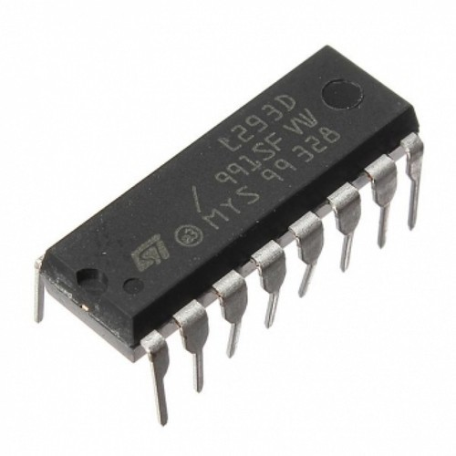
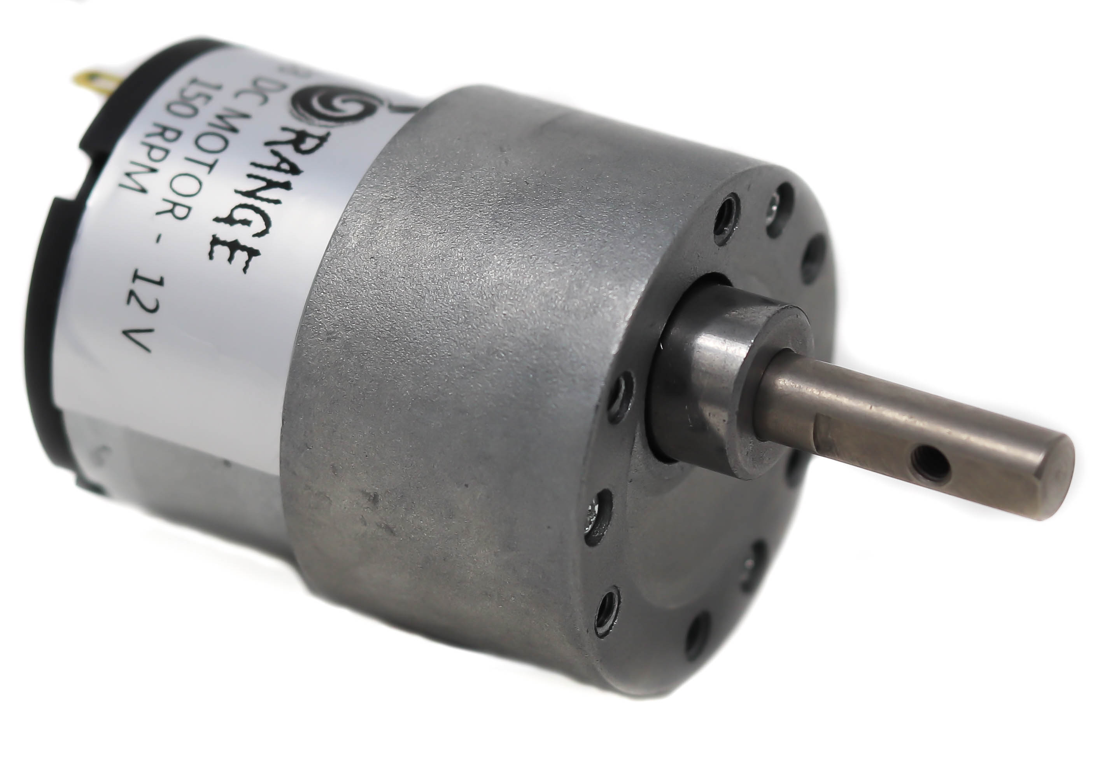
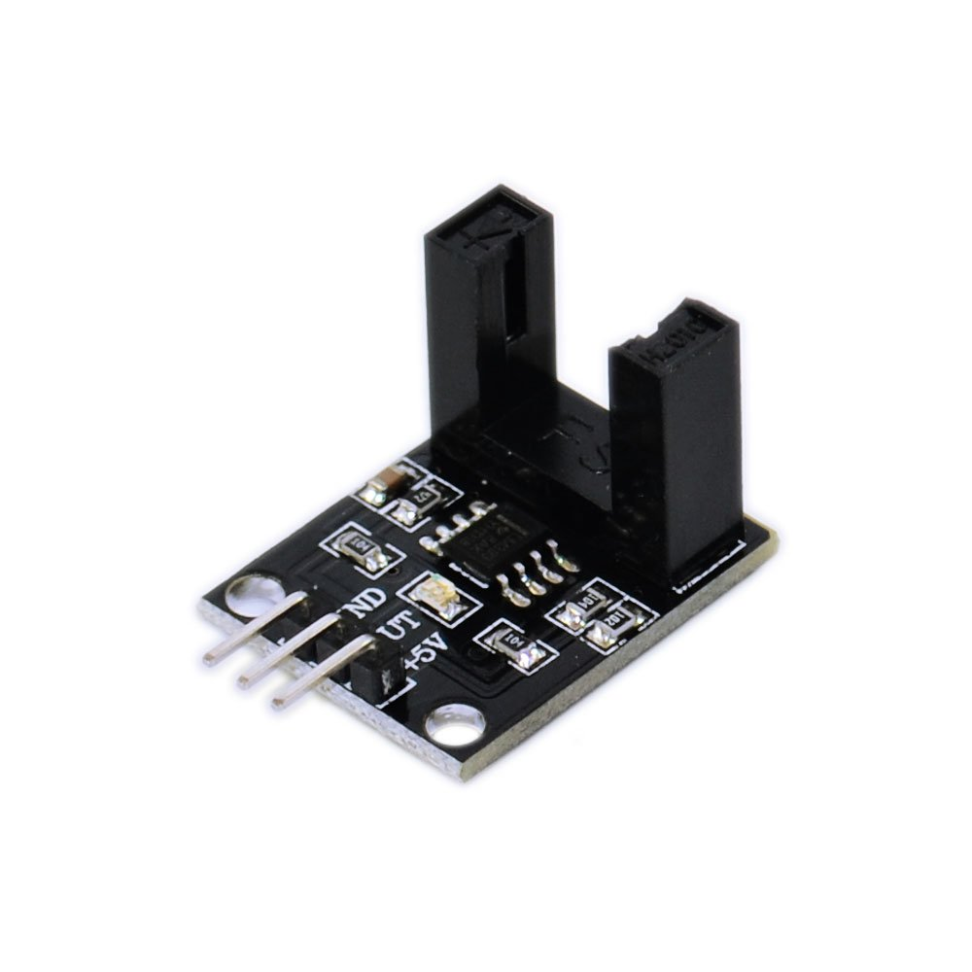
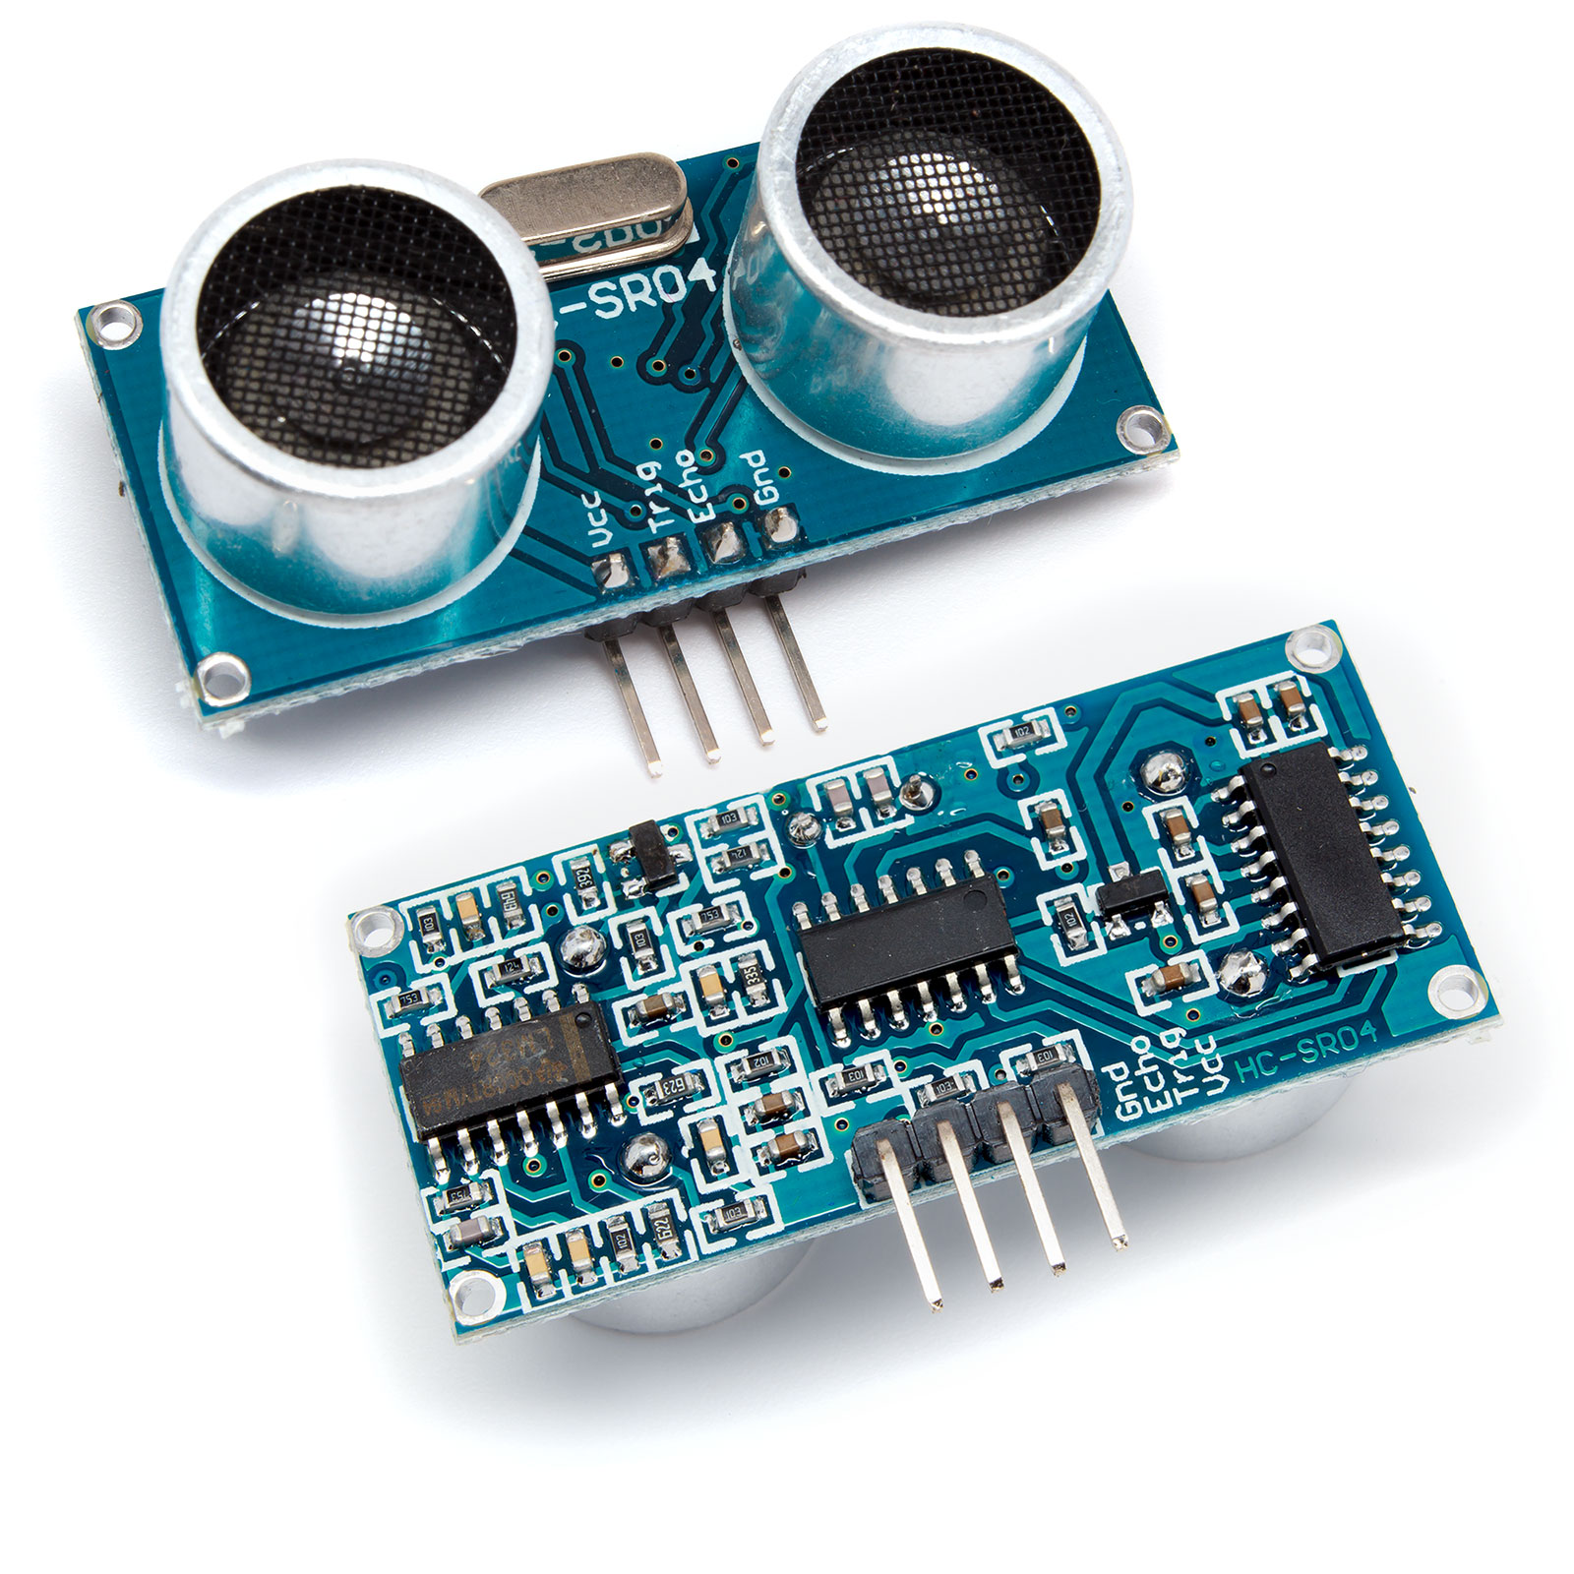
150 RPM MOTOR
L239 MOTOR CONROLLER
BOARD (CHIP)
OPTICAL MOTOR SPEED
SENSOR
SR04 RANGE FINDER

Slide 5
Sensors Explanation

Slide 6
L293D motor controller chip :
L293D is a typical Motor driver or Motor Driver IC which allows DC motor to drive on either direction. L293D is a 16-pin IC which can control a set of two DC motors simultaneously in any direction. It means that you can control two DC motor with a single L293D IC. The L293D can drive small and quiet big motors as well. It works on the concept of H-bridge. H-bridge is a circuit which allows the voltage to be flown in either direction. Voltage needs to change its direction for being able to rotate the motor in clockwise or anticlockwise direction, Hence H-bridge IC are ideal for driving a DC motor.

Slide 7
Infrared beam sensor :
A motor encoder is a rotary encoder mounted to an electric motor that provides closed loop feedback signals by tracking the speed and/or position of a motor shaft. The Photoelectric Speed Sensor Encoder Coded Disc code wheel is a Slotted Opto isolator module, with an IR transmitter & a photodiode mounted on it. Performs Non-Contact Object Sensing. This is normally used as positional sensor switch (limit switch) or as Position Encoder sensors used to find the position of the wheel. The module consists of IR LED and Photodiode mounted facing each other enclosed in the plastic body.

Slide 8
SR04 range finder (proximity sensor) :
This HC-SR04-Ultrasonic Range Finder is a very popular sensor which is found in many applications where it requires to measure distance and detect the objects. The module has two eyes like projects in the front which forms the Ultrasonic transmitter and Receiver. The HC-SR04 ultrasonic sensor uses sonar to determine the distance to an object. It has very handy and compact construction. It offers excellent range accuracy and stable readings in an easy-to-use package. Its operation is not affected by sunlight or black material.

Slide 9
About the board (esp32)
ESP32 is highly-integrated with in-built antenna switches, power amplifier, low-noise receive amplifier, filters, and power management modules. ESP32 adds priceless functionality and versatility to any applications with minimal Printed Circuit Board (PCB) requirements.
Programming an ESP32 device is as easy as programming an Arduino device. ESP32 can perform as a complete standalone system or as a slave device to a host MCU, reducing communication stack overhead on the main application processor. It can interface with other systems to provide Wi-Fi and Bluetooth functionality through its SPI / SDIO or I2C / UART interfaces. Another huge advantage with that ESP32 is that it not just supports the latest BLE Bluetooth 4.2, it also supports classic Bluetooth. It basically means it can speak to old and new Bluetooth phones/tables.
The board is capable of functioning reliably in industrial environments, with an operating temperature ranging from –40°C to +125°C. Powered by advanced calibration circuitries, ESP32 can dynamically remove external circuit imperfections and adapt to changes in external conditions.

Slide 10
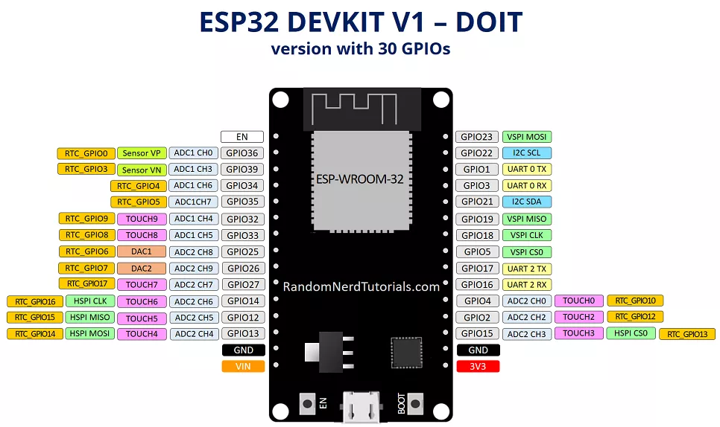
Furthermore, Espressif has added a dual-core CPU, larger RAM, more internal memory, and a bunch of hardware functions. The resulting system was powerful to answer the needs of modern IoT devices when we think of security, performance, energy efficiency and physical dimensions. However the specifications are subject to change, an average ESP32 SoC (System on Chip) has one 240Mhz CPU for applications, another 80Mhz CPU for wireless communications, 4MB of internal flash memory, 150 Mbits Wi-Fi, Bluetooth 4.2 and Bluetooth Low Energy (BLE) functions. It also features common microcontroller functionalities like PWM, ADC, DAC, I2C, SPI, and UART. So, with an ESP32 device, you'll have the power to make any IoT device with minimum budget and effort.
Finally coming to the specifications of the board :
The ESP32 is dual core, this means it has 2 processors.
It has Wi-Fi and Bluetooth built-in.
It runs 32 bit programs.
The clock frequency can go up to 240MHz and it has a 512 kB RAM.
This particular board has 30 or 36 pins, 15 in each row.
It also has wide variety of peripherals available, like: capacitive touch, ADCs, DACs, UART, SPI, I2C and much more.
It comes with built-in hall effect sensor and built-in temperature sensor.

Slide 11
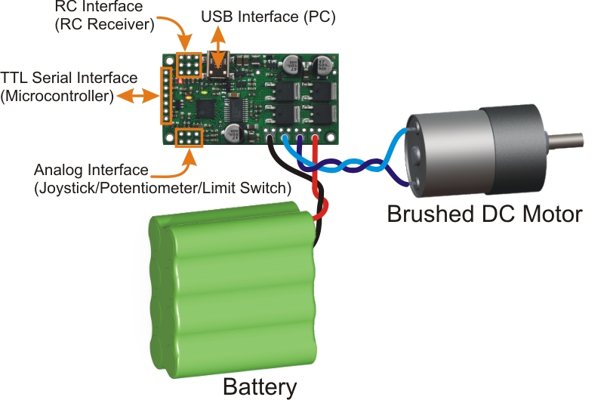
Approach to the Project
The ESP32 (board) has a Wi-Fi chip enabling it to communicate with the other nodes in the project.
The board is connected to the motor controller board which in turn is connected to the motor.
The ESP32 board is programmed to control and vary the speed of the motor.
The written arduino code will use PWM mechanism to change the speed.

Slide 12
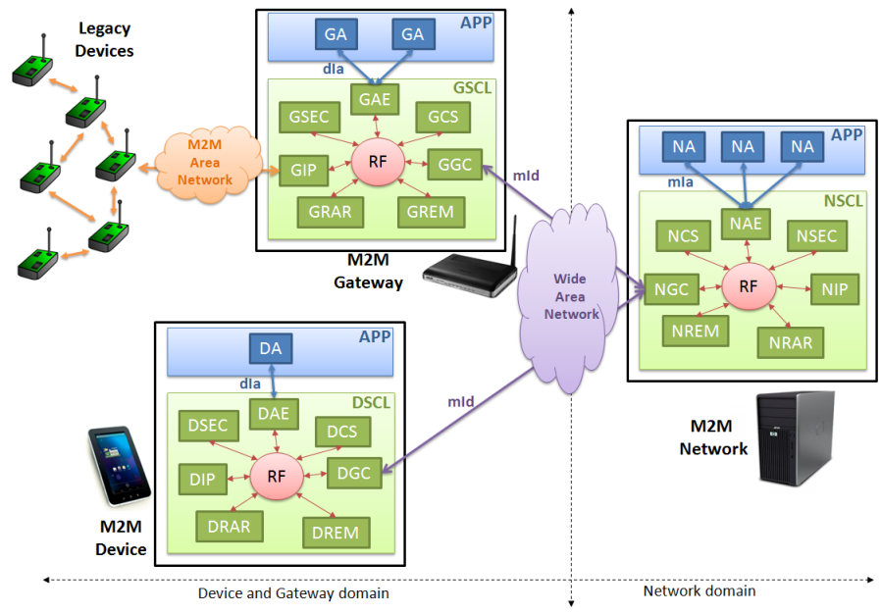
There are 2 proximity sensors attached to the motor. Each of these senses if an object is close to the motor and accordingly varies its speed by slowing it down.
The parameters such as speed, distance are then written to the cloud using the OneM2M protocol.
This rudimentary approach to controlling a motor and recording a change in the variables can now be extended to other applications.
One such application includes controlling a driverless vehicle using this IOT application

Slide 13
Code Explanation

Slide 14
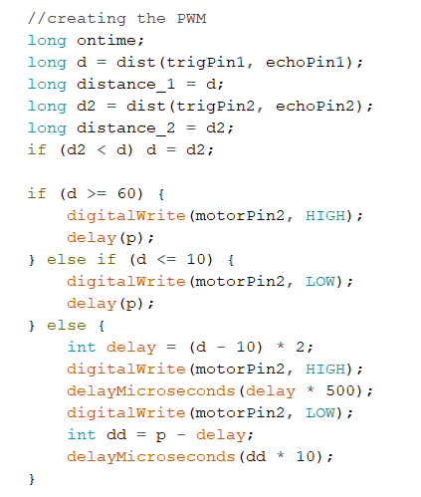
PWM Generation
Both SR04 detect the distances. Minimum of the two is chosen. If minimum is >= 60, it will run at the highest speed. If it is <=10, it will stop. Otherwise it is varied linearly according to PWM.

Slide 15
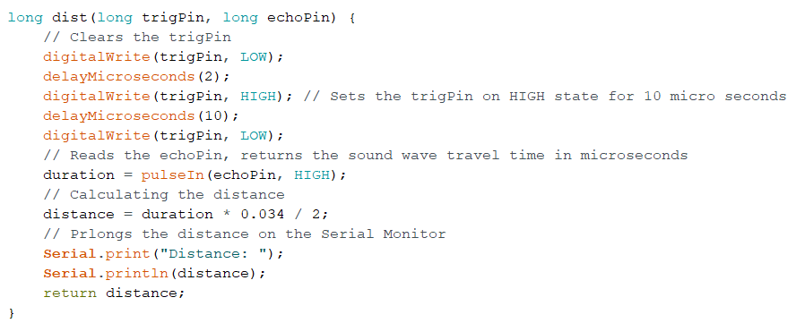
Detecting the distance

Slide 16
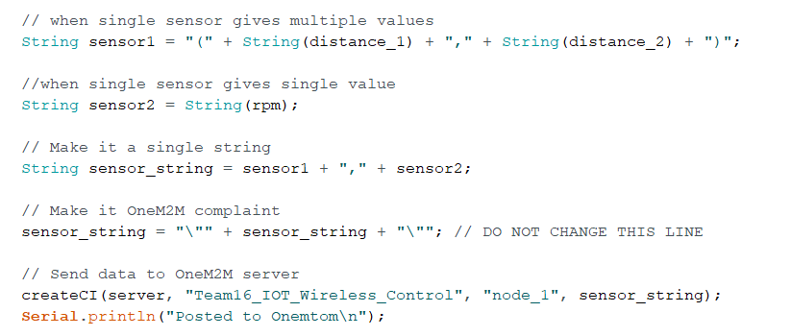
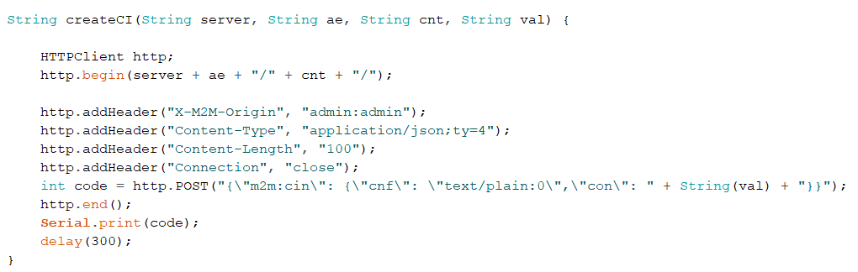
Posting data to OneM2M

Slide 17
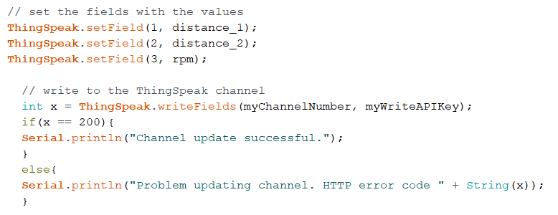
Posting to ThingSpeak

Slide 18
Data Collected on Server

Slide 19
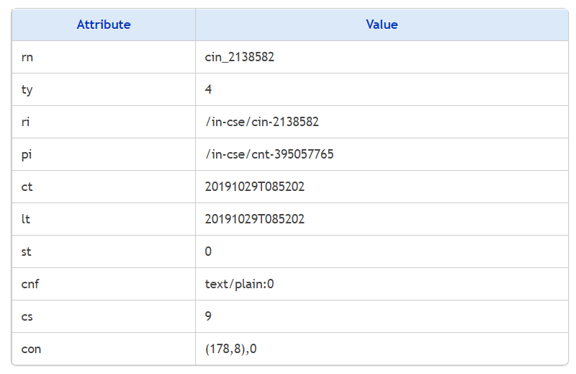
OneM2M

Slide 20
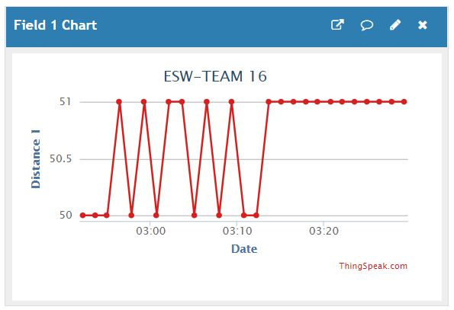
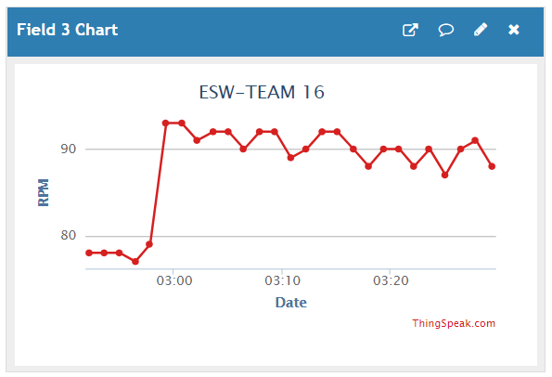
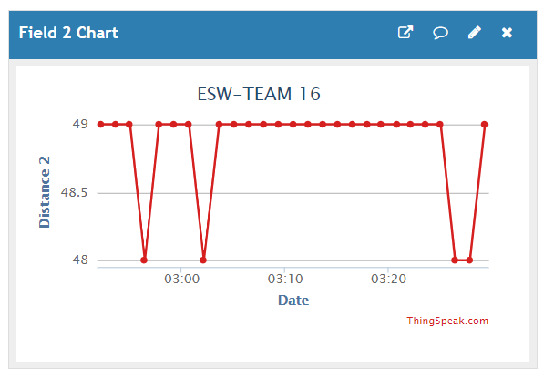
ThingSpeak

Slide 21
Model in Reality

Slide 22
